Slide 1



Slide 2

Distributed Multimedia Systems
GROUP NO: 08
MEMBERS:
MEHEDI HASAN EMON RIFAT AHMED

Slide 3
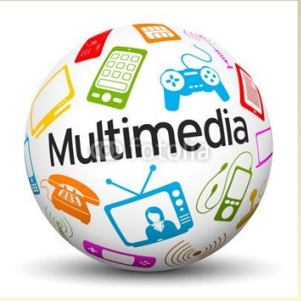
Table of contents
INTRODUCTION
CHARACTERISTICS OF DS
REQUIREMENTS OF DMMS
DISTRIBUTE SYSTEM ARCHITECTURE
PROXY AND WIRELESS CONNECTION
SOME FACTORS AND APPROACHES
TYPICAL COMPUTER APPLICATION
CHARACTERISTICS OF NETWORK TRAFFIC
QOS (QUALITY OF SERVICE)
WHY WE NEED QOS
CONGESTION CONTROL AND ADMISSION CONTROL
APPLICATIONS OF DMMS
CONCLUSION

Slide 4

Introduction What is Distributed System ?
A network of autonomous computers that communicate by message passing to perform some task
Autonomous: able to act independently
Communication: shared memory or message passing

Slide 5
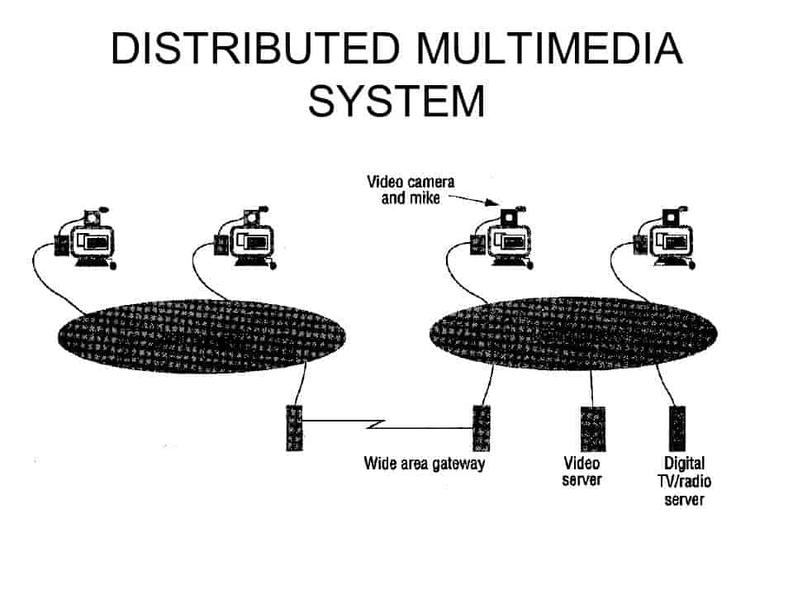
What is Distributed multimedia systems ?
Distributed multimedia systems consist of multimedia databases, proxy and information servers, and clients, and are intended to for the distribution of multimedia content over the
networks.

Slide 6


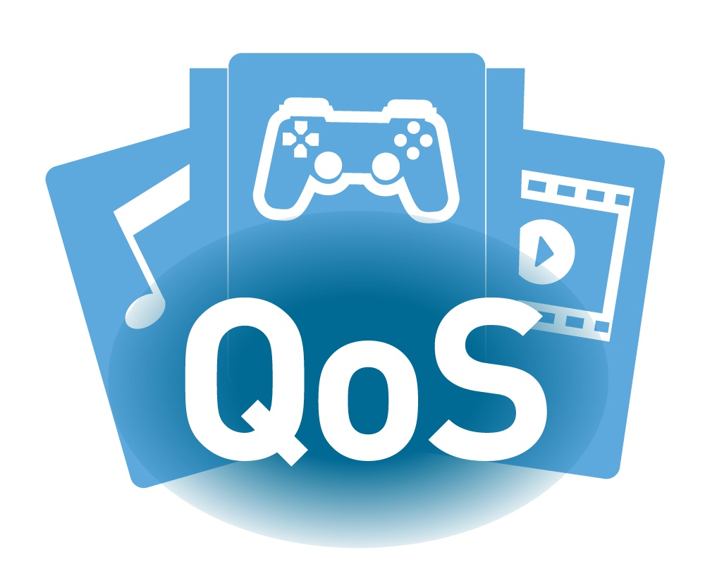
Characteristics Of Distributed Multimedia Systems
Delivering the streams of multimedia data
Audio samples, Video frames
To meet the timing requirements
QoS ( Quality of Service )
Flexibility (adapting to user needs)
Availability
Scalability -Scalability is the measure of a system’s ability to increase or decrease in performance and cost in response to changes in application and system processing demands

Slide 7
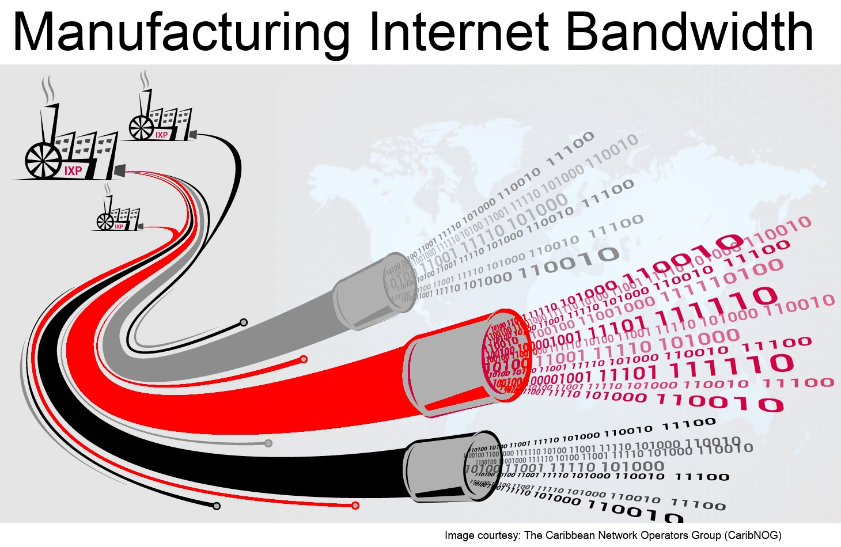

REQUIREMENTS OF DMMS
Providing support for continuous media types, such as audio, video and animation
The introduction of such continuous media data to distributed systems demands
the need for continuous data transfers over relatively long periods of time.
-High bandwidth is required.
The second requirement of distributed multimedia applications is the need for sophisticated quality of service (QoS) management.
-Ensuring that the service requests should be met.
Supporting multiparty communications. Many distributed multimedia applications are concerned with interactions between dispersed groups of users.
-Example: Remote conference application.

Slide 8

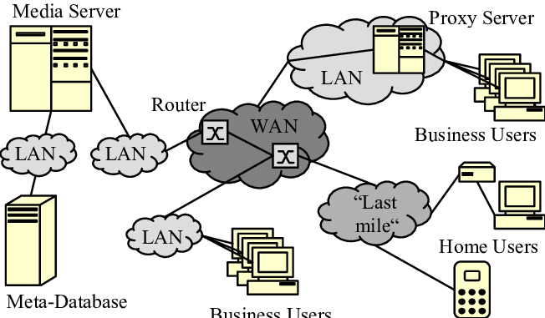
Distribute Systems Architecture
Database
Proxy/information servers
Clients
Wired or wireless networks

Slide 9





Proxy

Slide 10

What’s a Proxy Server?
A proxy server acts as a gateway between you and the internet. It’s an intermediary server separating end users from the websites they browse. Proxy servers provide varying levels of functionality, security, and privacy depending on your use case, needs, or company policy

Slide 11
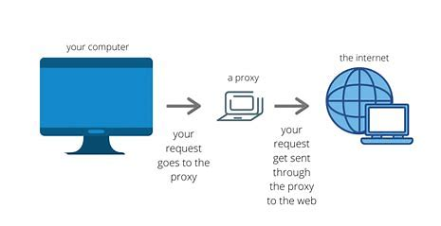
How a Proxy Server work?

Slide 12
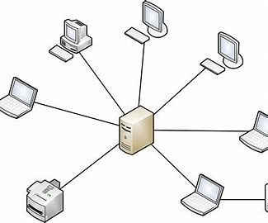
Client-Server Definition
The term ‘Client-Server’ refers to the Network Architecture. where one or more computers are connected a server

Slide 13
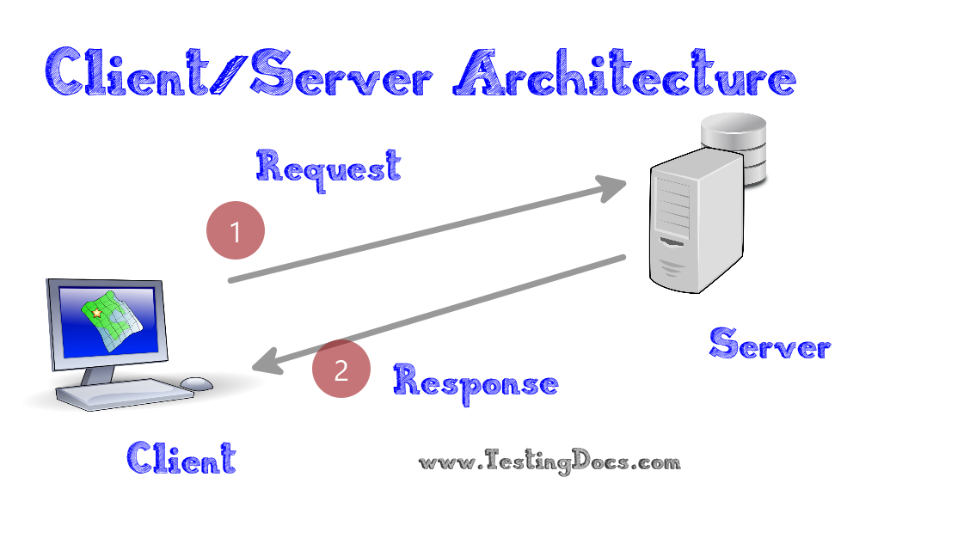
How the Client-Server Model works ?
In the client-server architecture, when the client computer sends a request for data to the server through the internet, the server accepts the requested process and deliver the data packets requested back to the client. Clients do not share any of their resources. Examples of Client-Server Model are Email, World Wide Web, etc.

Slide 14
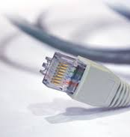
Wireless Networks
The term wireless refers to the communication of information over a distance,
without requiring wires, cables or electrical conductors.
Information is transmitted through air , without requiring any cables by using
Electro magnetic waves like radio frequencies, infrared, satellite etc

Slide 15
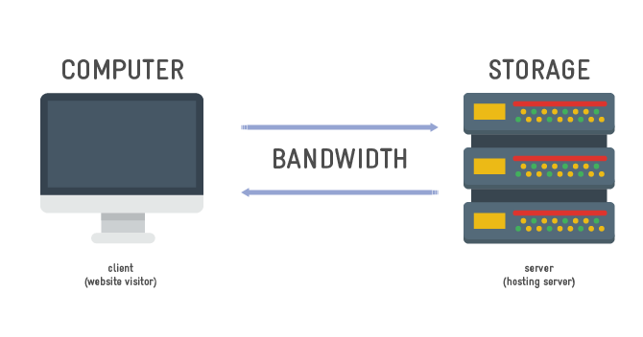

FACTORS THAT AFFECT THE SYSTEM
Server bandwidth
-Adequate bandwidth of the network to
support media streams
Cache space
- Sufficient cache space needed for the fast delivery
Number of copies
-Adequate number of copies of movies at the multimedia
databases (MMDs)
The number of clients
- Increasing number of clients increase the server
work -load

Slide 16
APPROACHES
Proxy-based approach
Parallel or clustered server's approach
Varies depending on clip duration, number
of clients, bandwidth available, etc
Caching- Caching allows nodes to quickly fetch the required documents without incurring the need to contact the original host

Slide 17

Multimedia

Slide 18

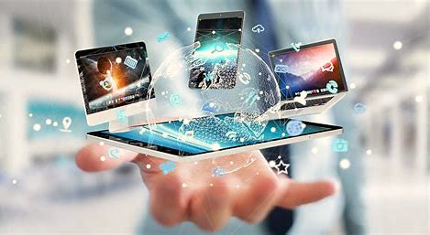
Definition of Multimedia
Multimedia is a combination of text, graphic, sound, animation, and video that is delivered interactively to the user by electronic or digitally manipulated means.

Slide 19


Multimedia Application
Video conferencing
Games
Home shopping
Virtual reality
Digital Video editing
Multimedia database system

Slide 20
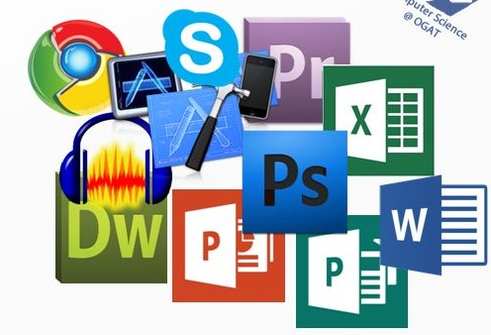
Typical Computer Application
Browsers
Word processing
Audio & video editing
Spreadsheet
Web design
Graphic design

Slide 21
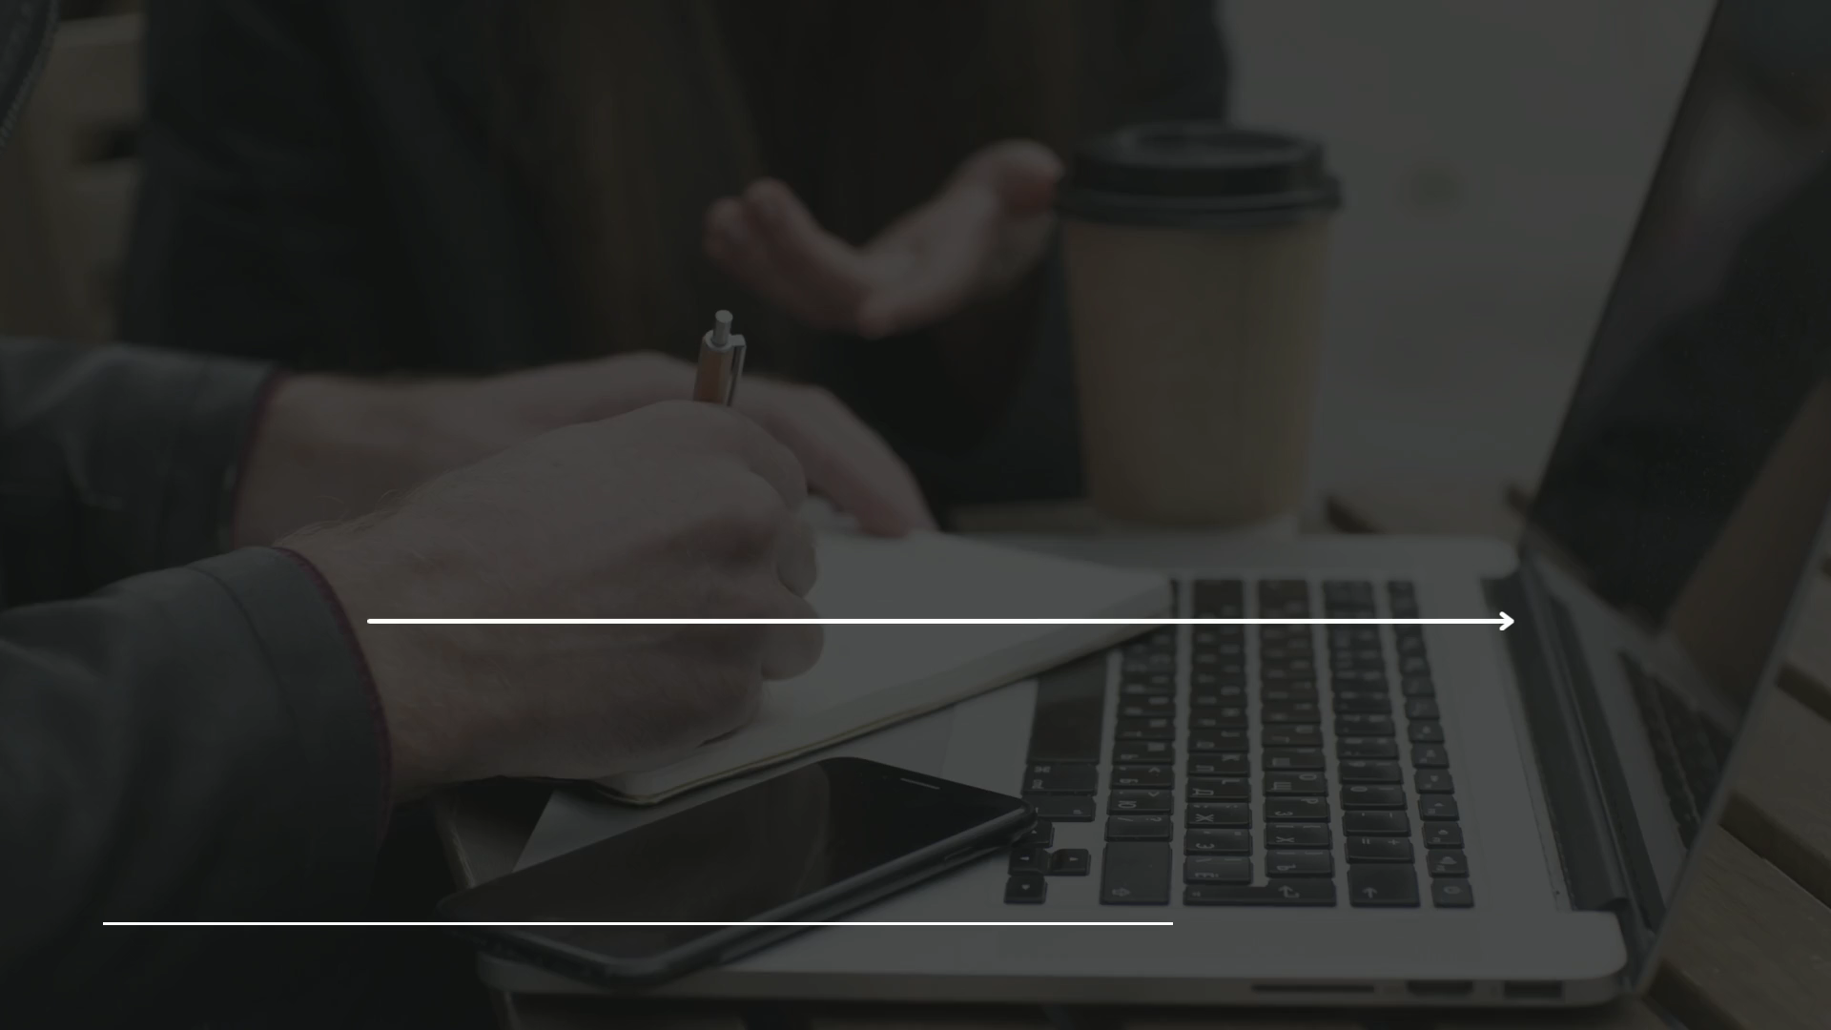

Slide 22

Quality of Service (QoS)
Quality of service (QoS) is the overall performance of a telephony or computer network, particularly the performance seen by the users of the network.
To quantitatively measure quality of service, several related aspects of the network service are often considered, such as error rates, bandwidth, throughput, transmission delay, availability, jitter, reliability etc.
We can formally define QoS as something a flow seeks to attain.
We will discuss these Flow Characteristics one by one.

Slide 23

Bandwidth
The concept of Internet bandwidth refers to the amount of data that may be transferred over an Internet connection per second. Bandwidth is measured in bits per second, and most Internet connections have a bandwidth on the scale of megabits per second. Every Internet connection has a specified maximum bandwidth, but many factors can combine to limit this for a particular device. This results in a slowness of the perceived speed of a connection.
QoS policy should prioritize the use of bandwidth to provide quality of service to customers or users.
Different applications needs different bandwidths.
For example, in video conferencing we need to send millions of bits per second to refresh a color stream while the total number of bits in an email may not reach even a million.

Slide 24
TRANSMISSION DELAY
Source-to-destination delay is another important aspect of a flow characteristics.
In a network based on packet switching, transmission delay is the amount of time required to push all of the packet's bits into the wire. In other words, this is the delay caused by the data-rate of the link.
Applications can tolerate delay in different degrees.
Telephony, audio conferencing, video conferencing, and remote log-in need minimum delay, while delay in file transfer or email is less important.
It is given by the following formula: Dt=N/R secs N:number of bits R:rate of transmission

Slide 25
JITTER
Jitter is the variation in delay for packets belonging to the same flow. Packets from the source will reach the destination with different delays. A packet's delay varies with its position in the queues of the routers along the path between source and destination and this position can vary unpredictably. This variation in delay is known as jitter and can seriously affect the quality of streaming audio and/or video.
For example, if four packets departs at times 0,1,2,3 and arrives at 20,21,22,33, all have the same delay of unit 20. On the other hand, if the above four packets arrives at 21,23,21, and 28, they will have different delays:21,22,19,24.
For applications such as video and audio the first case is acceptable but the second case is not.
High jitter means difference between delays is large. Low jitter means variation is small.

Slide 26
WHY WE NEED Qos
1. We may get the wrong video – Bad search facilities
2. We may get the wrong quality-variation – E.g too high-quality level for a PDA
3. We may get the proper variation in bad quality – E.g jitter is too high
4. We may get the video at the wrong time

Slide 27

WAYS TO ACHIEVE QoS
Buffering (on both ends)
Compression
More load on the nodes, but that is okay
Bandwidth Reservation
Resource Scheduling
Traffic Shaping
Flow Specifications
Stream Adaptation

Slide 28
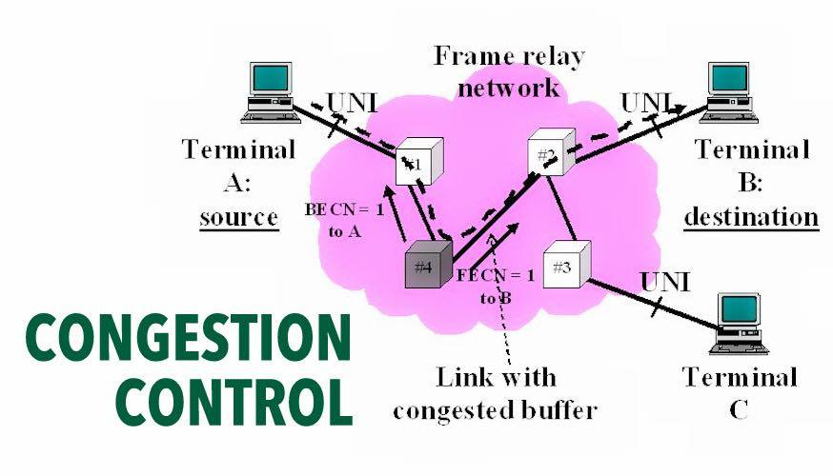
Congestion Control
Congestion control is a network layer issue, and is thus concerned with what happens when there is more data in the network than can be sent with reasonable packet delays, no lost packets, etc. Flow control is a local, congestion control is global.

Slide 29
What is Admission control?
▪ Admission control is a validation process in communication systems where a check is performed before a connection is established to see if current resources are sufficient for the proposed connection.
▪ Routers or switches puts restrictions on the admission of packets from host.
▪ Before a router accepts the flow, it checks the flow for specifications in terms of bandwidth , buffer size ,cpu speed etc

Slide 30
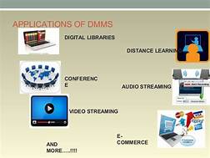
APPLICATIONS OF DMMS
DIGITAL LIBRARIES
DISTANCE LEARNING
CONFERENCE
AUDIO STREAMING
VIDEO STREAMING
E-COMMERCE

Slide 31


